Slide 1
Oracle GoldenGate 18.1 Microservices Hands-On Workshop
March - 2019
Firstname Lastname
Firstname.Lastname @oracle.com
Cloud Integration Specialist
Oracle Integration Solutions
Firstname Lastname
Firstname.Lastname @oracle.com
Integration Sales Manager

Slide 2
Notes:
This is a Safe Harbor Front slide, one of two Safe Harbor Statement slides included in this template.
One of the Safe Harbor slides must be used if your presentation covers material affected by Oracle’s Revenue Recognition Policy
To learn more about this policy, e-mail: Revrec-americasiebc_us@oracle.com
For internal communication, Safe Harbor Statements are not required. However, there is an applicable disclaimer (Exhibit E) that should be used, found in the Oracle Revenue Recognition Policy for Future Product Communications. Copy and paste this link into a web browser, to find out more information.
http://my.oracle.com/site/fin/gfo/GlobalProcesses/cnt452504.pdf
For all external communications such as press release, roadmaps, PowerPoint presentations, Safe Harbor Statements are required. You can refer to the link mentioned above to find out additional information/disclaimers required depending on your audience.

Slide 3
Workshop will begin at 9am. Please Check Your Connectivity Now
Connect to the wireless/wired network “clear-guest”.
Open a browser (if necessary) to log in : username: guest password: xxxxxxxxx
Download VNC Viewer if not already downloaded :
https://www.realvnc.com/en/connect/download/viewer/
4. Ensure you can fire up VNC Viewer. Your hostname or IP Address was assigned on the sign-in sheet.
Using VNCViewer Host: hostname or assigned IP address:5901 Password = Welcome1
If you are able to see Linux terminal, you are all set to start the Labs.

Slide 4
Agenda Topics | Time
Breakfast and Network Setup | 8:30 - 9:00
Oracle GoldenGate Overview and Introduction to Microservices Architecture | 9:00 - 11:30
Break | 11:30- 11:45
Lab 100 : Install GoldenGate Microservices Architecture | 11:45 - 12:00
Lab 200 : Creating Deployments for Oracle GoldenGate Microservices Architecture | 12:00 -12:15
Lab 300 : Creating Credentials | 12:15 - 12:30
Lunch | 12:30 – 1:30
Lab 400 : Uni Directional and DDL Replication | 1:30 - 2:15
Lab 500 : Zero Downtime Configuration | 2:15 - 2:45
Lab 600 : Bi-Directional and Auto Conflict Detection and Resolution(CDR) | 2:45 - 3:15
Lab 700 : Heterogeneous Replication | 3:15 – Onwards
Lab 800 : Data Transformations | Contd…
Lab 900 : Performance Metrics | Contd…
Lab 9100 : Replicating into Oracle Autonomous Data Warehouse from Heterogeneous database | Contd…
Question & Answers – Closing Remarks | 3:15 – 3:30

Slide 5






Oracle Cloud: Bringing Cloud Agility to Enterprises
Integrated SaaS, PaaS and IaaS with deployment choice
SaaS
PaaS
IaaS
On-Premises
Off-Premises

Slide 6

Oracle Cloud Platform
Comprehensive
Open
Integrated
Hybrid
Data Management
Analytics and Big Data
Application Development
Content & Experience
Enterprise Integration
Identity & Security
Oracle Cloud
Oracle Cloud at Customer
Data Integration
Systems Management
Oracle Data Center
Your Data Center
Built on High Performant Oracle Cloud Infrastructure

Slide 7
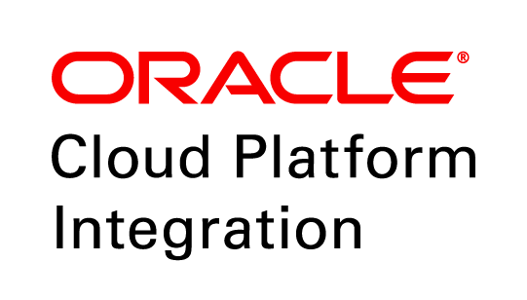


Oracle Integration Platform
APPLICATION INTEGRATION
Converged Solution for All Integration Needs
Complete
Data
Governance
API
MANAGEMENT
Simplified
Data
Quality
Process Automation
Integration Platform
Open
Stream analytics
Bulk Data Transformation
Real Time Data Streaming and Data Replication
Copyright © 2017, Oracle and/or its affiliates. All rights reserved.
7

Slide 8






Oracle Autonomous Integration
Application Integration
Persona-based User Experience
Integration Specialist
Applications IT
Lines of Business
API Management
Application Integration
Cloud
CX
HCM
ERP
+
Process Automation
Design
Hybrid
Self Service Integration
Govern
Cloud at Customer
Visual Builder
Manage
Monetize
On-premises

Slide 9


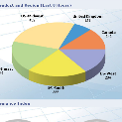

Oracle Platform for Data Integration
Data Integration
Role-based User Experience
DBAs & Architects
ETL Developers
Data
Engineer
Deployment Flexibility
Any Streaming
Data Lakes
Governance
Streaming & Replication
Cloud
Data Governance
+
Any Cloud
ELT & Bulk Data
Hybrid
Any Application
Cloud at Customer
Data Quality
Any Database
Data Warehouses
Data
On-premises

Slide 10
GoldenGate
Overview

Slide 11




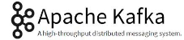


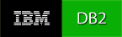



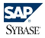





Oracle GoldenGate
Oracle GoldenGate provides low-impact capture, routing, transformation, and delivery of database transactions across homogeneous and heterogeneous environments in real-time with no distance limitations.
Most Databases
Cloud
Data Events
Transaction Streams
Big Data
Real-time Performance
DBs
Extensible & Flexible
* The most popular enterprise integration tool in history
Proven & Reliable
Supports Databases, Big Data and NoSQL:
Heterogeneous

Slide 12
Oracle GoldenGate Supported Platforms
Databases | O/S and Platforms
Oracle GoldenGate Capture/Delivery: Oracle DB2 DB2 on z/OS iSeries Microsoft SQL Server Sybase ASE Teradata Enscribe, SQL/MP, SQL/MX MySQL JMS message queues Cassandra Oracle GoldenGate Delivery: TimesTen, Coherence, Postgres HDFS, Hive, Flume, Mongo Db, NoSql ADLS, Azure SQL, Big Query Flat Files to Netezza, Greenplum, ETL | Linux Sun Solaris Windows HP NonStop HP-UX IBM AIX IBM z Series IBM i Series zLinux
12

Slide 13








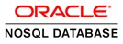

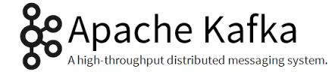




Oracle GoldenGate
Use Cases
Fully Active Distributed DB
High Availability & Disaster Recovery
New DB/ HW/OS/APP
Zero Downtime Upgrades & Data Migration
Global Data Centers
Data Synchronization Across the Enterprise
GoldenGate
Big Data, DW & Marts
Real-time BI, Hadoop Data Staging, Data Ingestion
Real-time Data Delivery
Application Offloading
Query & Report Offloading
JMS
Message Bus & Data Grid
Event Driven Architecture, SOA/MQ, Coherence
JMS
Data Streaming
Real-time Analytics
& Massive Parallelization
Notes:
Is IBM Informix and Sybase still supported?

Slide 14
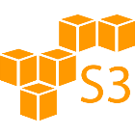

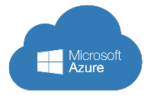

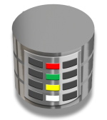




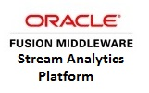
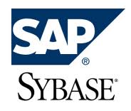

GoldenGate : Use Cases
Fully Active Distributed DB
High Availability & Disaster Recovery
New DB/ HW/OS/APP
Zero Downtime Upgrades & Data Migration
Global Data Centers
Data Synchronization Across the Enterprise
Capture
Trail
Pump
Route
Deliver
Real-time BI, Hadoop Data Staging, Data Ingestion
Big Data, DW & Marts
GoldenGate
Application Offloading
Query & Report Offloading
Real-time Data Delivery
JMS
Message Bus & Data Grid
Event Driven Architecture, SOA/MQ, Coherence
JMS
Data Streaming
Real-time Analytics
& Massive Parallelization

Slide 15
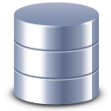
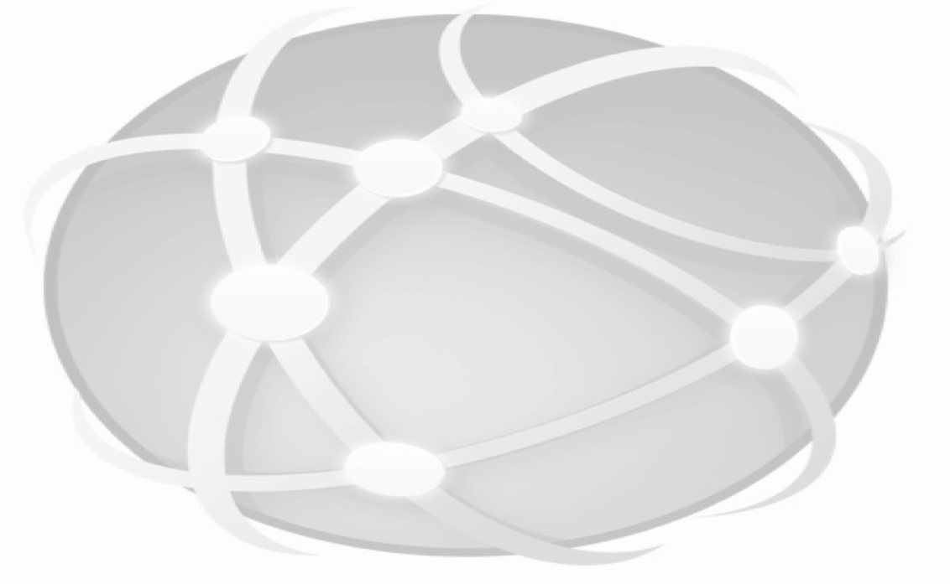
Oracle GoldenGate Classic Modular Architecture
Capture
Trail
Files
Pump
Trail
Files
Delivery
LAN / WAN / Internet
Over TCP/IP
Trail
Files
Trail
Files
Capture
Source Oracle / Non-Oracle Database
Delivery
Pump
Target Oracle / Non-Oracle Database
Bi-directional
High performance, even in high-volume systems
Low impact on the infrastructure
Non-intrusive
Flexible, supports heterogeneous systems
Reliable, resilient against interruptions, outages

Slide 16




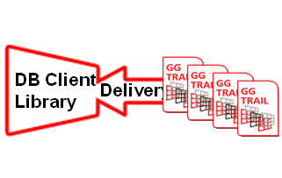
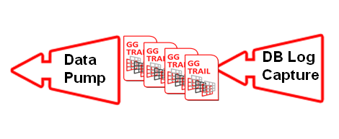
Oracle GoldenGate 12c Classic Architecture
CAPTURE:
Committed changes are extracted as they occur by reading the transaction logs
Data can be filtered & supplemented
GG TRAIL:
Persisted message store.
Queues data for routing
Optional AES Encrypted
PUMP:
Distribute data for routing to one or multiple targets.
Data can be filtered, divided into subsets, transformed & supplemented
ROUTE:
Data can be compressed and encrypted for transmission.
TCP/IP Streaming Protocol
DELIVERY:
Applies data with transaction integrity.
Ability to transform the data and DML.
Parallelism for scalability
GG MANAGER
GG MANAGER
TCP /IP
LAN / WAN /
Internet
DB Log
Capture
Data
Pump
Delivery
DB Client
Library
Source Trails
Target Trails
Bi-Directional | Active-Active | Fail-back
Source Database & Logs
Target Database & Logs
GG MANAGER: Process: Start - Stop – Restart, Trail File Housekeeping & Management, Event Monitoring & Reporting
Capture Platforms: Oracle, DB2 (LUW, Z/OS i-Series), Informix , Microsoft SQL Server, Sybase ASE, Teradata, Enscribe, SQL/MP, SQL/MX, MySQL, JMS Queues
Delivery Platforms: All Capture Platforms, TimesTen, Cohernece, Netezza, Greenplum, PostgresSQL, Formatted & Flat Files, ODI, other ETL tools, and Big Data
OS Platforms: Microsoft Windows, Linux, Sun Solaris, HP NonStop, HP-UX, HP OpenVMS, IBM AIX, z/OS, i7/OS

Slide 17

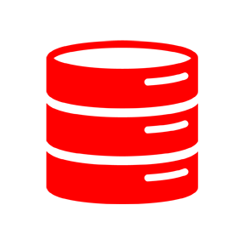

Oracle GoldenGate
Classic Architecture – Oracle & Heterogenous
GGSCI
Capture
Trail Files
Pump
Network
Collector
Trail Files
Delivery
Manager
Manager

Slide 18

Oracle GoldenGate
Microservices Architecture
Deploy
Embed
Automate
Customizable Interactive Experience
>>SQL
>HTML
>>CLI
>>API
HTTPS/Restful
Administration Service
Performance Metrics
Service
Capture
Trail Files
Distribution Service
Network
Receiver
Service
Trail Files
Delivery
Service Manager

Slide 19

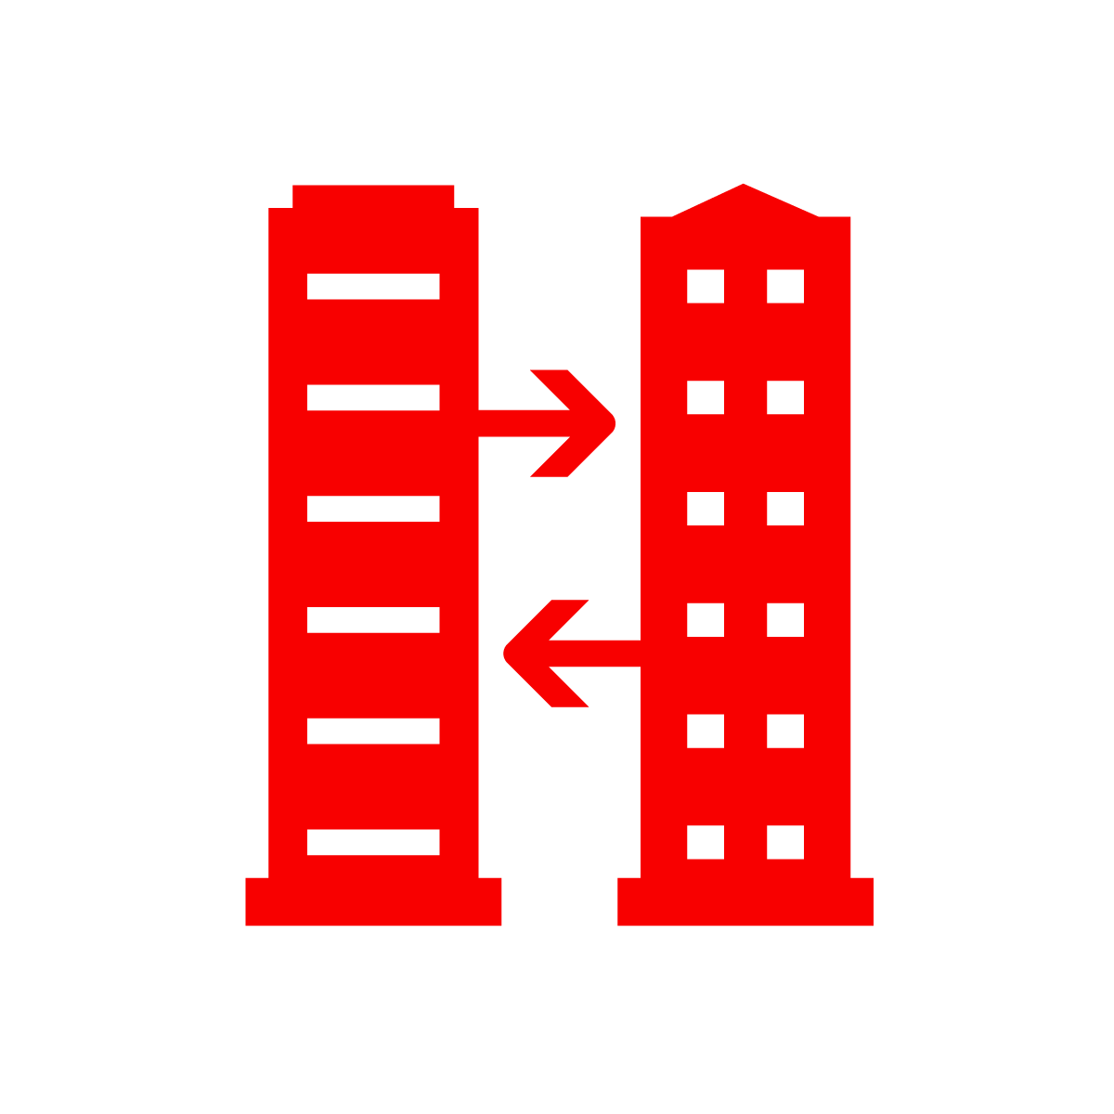



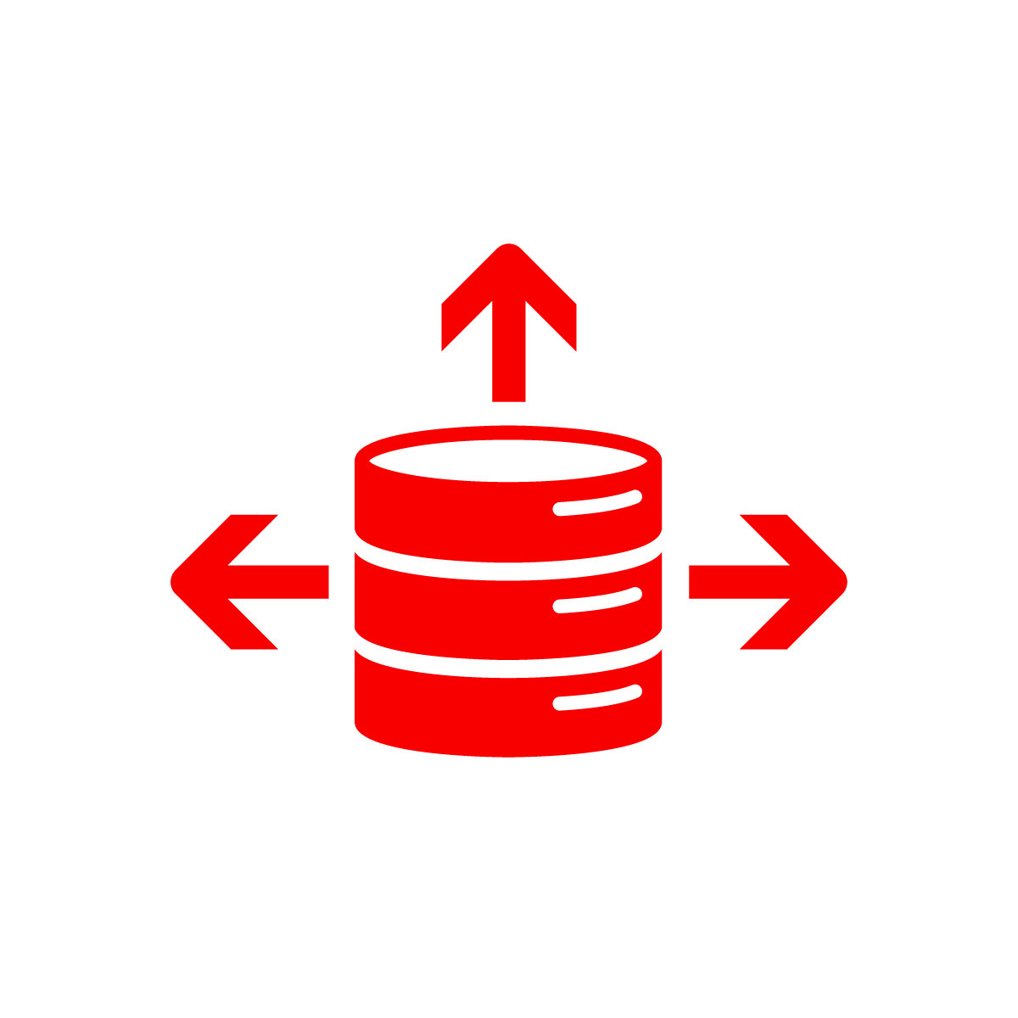
Oracle GoldenGate
Architectures – Flexible Deployments
Operational Reporting
High Availability
Load Balancing
Information Hubs
Big Data Warehousing
Streaming Analytics

Slide 20



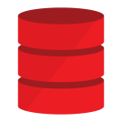





Hybrid Deployment Models
Operational Reporting
Test/Dev
Disaster Recovery
Zero Downtime Migration*
Zero Downtime Migration*
Load
Balancing
Geo
Distribution
Real-time Data Warehousing
Information Hubs
Database Consolidation
High Availability
Active-Active
On-Premises to Cloud
Cloud to On-Premises
Cloud to Cloud
On-Prem to On-Prem

Slide 21
GoldenGate
Microservices
Overview

Slide 22
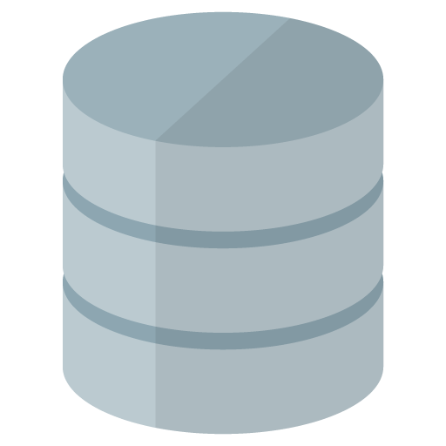

Microservices Architecture for Cloud and Large-scale Deployments
Administration, Distribution, Receiver, Metrics Services with RESTful Service Interfaces
HTTPS RESTFul Service Interfaces
Admin Server
Admin Server
Source
Database
Target
Database
Metrics Server
Metrics Server
Distribution Service
Receiver Service
Trail Files
Extract
Trail Files
Replicat
Service Manager
Service Manager
Source
Target

Slide 23
Common Key Attributes and Benefits of Each Service
Enables remote configuration, monitoring, and administration
Provides formal RESTful service interfaces
Industry-standard communications protocol: HTTPS, JSON
Enables Applications to Embed GoldenGate
Secure
Authorize identity of clients with username / password or SSL client certificates
Discover
Catalog of all RESTful methods with link based navigation.
Contains an embedded HTML5 application for simple browser based monitoring and administration (no web server needed)

Slide 24



Solutions For Everyone
Administrators
Traditionalists
DevOps
Simple to use Web interfaces
Get up and running quickly
Lower learning curve
Command Line access via adminclient – run anywhere
Similar GoldenGate commands as in GGSCI
Interaction the same as previous releases, just thin client
Uses RESTful APIs
Run anywhere
Roll your own monitoring
Notes:
http://www.istockphoto.com/vector/computer-help-line-vector-icons-set-gm495781011-41027036 (for images to purchase)

Slide 25

Security Model
Standard TLS/SSL based authentication and Client Authorization
Clients
Client Authorization
Identity via SSL user certificates or via username/password
Roles
Security User
Administrator
Operator
User
SSL User Certificate
User/ Passwd
HTTPS
GoldenGate
Services
SSL Server Certificate
Authorized Clients

Slide 26

Cloud Ready
Remote and secure administration and data communication in cloud environments
Internal Network
DMZ
GoldenGate
Services Deployment
Reverse Proxy
HTTPS
GoldenGate
Services Deployment
wss
Remote Administration and Configuration
No OS access required after installation
Secure administration and data transport
Works with all standard HTTP proxy and reverse proxy servers

Slide 27
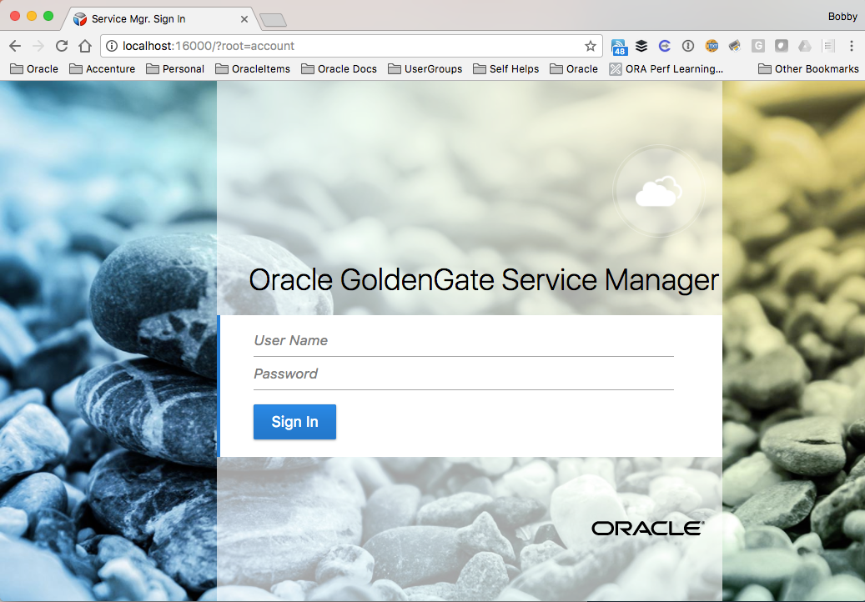
WebPage Interfaces
Access via URL http(s)://<hostname>:<port>

Slide 28
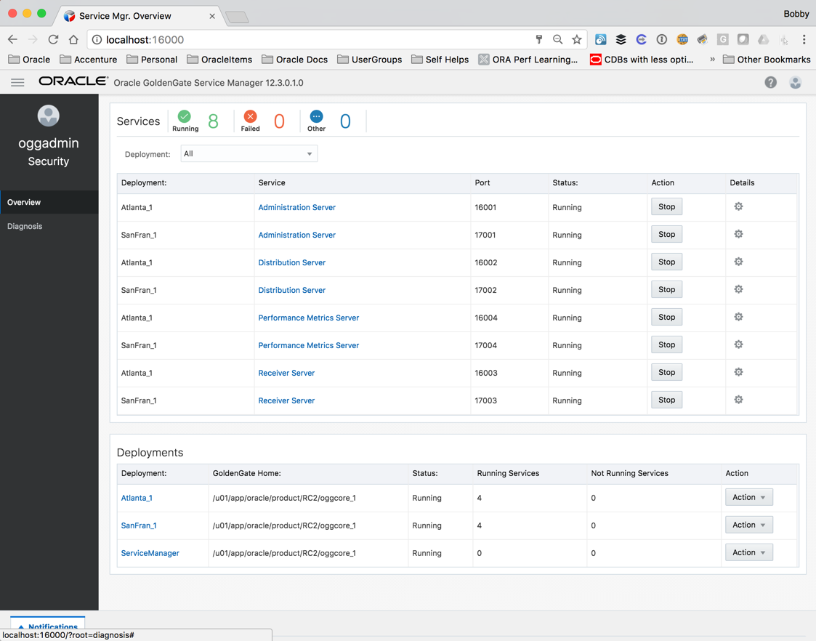
Oracle GoldenGate Service Manager
Access via URL (http(s)://<hostname>:<port>
i.e. http://localhost:16000
Use Administration User for access:
i.e. oggadmin/********
Maintains inventory and configuration information about all deployments
Watchdog process for Other OGG Services
Runs as a daemon
Auto-Restart
Inventory Info stored in /etc/oggInv.loc

Slide 29
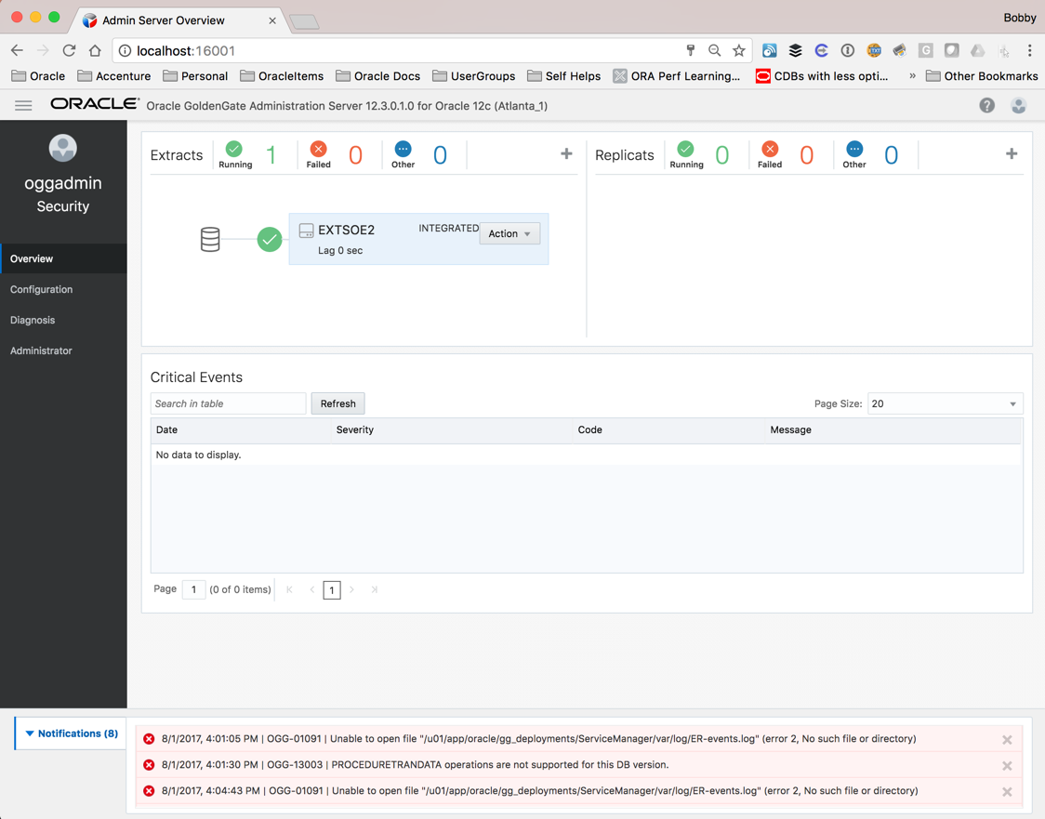
Oracle GoldenGate Administration Server - Overview
Access via URL (http(s)://<hostname>:<port>)
i.e. http://localhost:16001
Manage Extracts/Replicats
Create, delete, start/stop, reports, statistics
View critical events/messages
View notifications per page

Slide 30
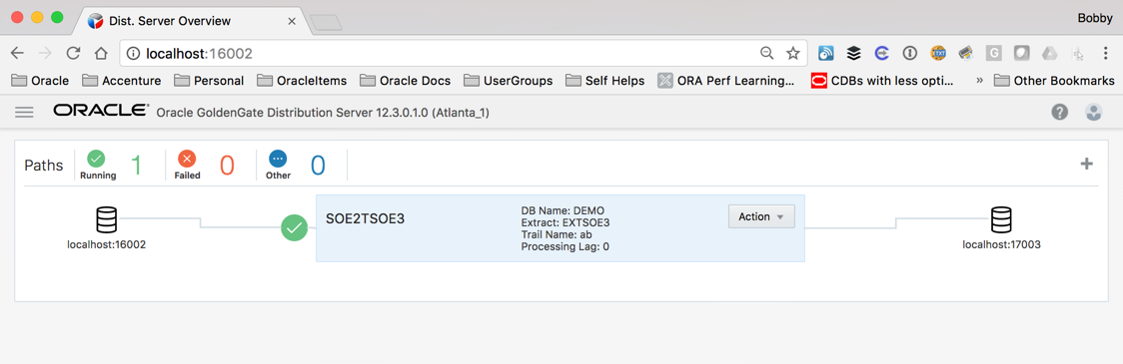
Oracle GoldenGate Distribution Server
Access via URL (http(s)://<hostname>:<port>)
i.e. http://localhost:16002
Replacement for the Extract Pump process
Quickly identify source, trail file, and destination
Distributes one or more trails to one or more destination
Does not support transformations
Supports multiple transport protocols
Tunable per network path

Slide 31

Communication Protocol
Industry standard HTTP(S) initiated full-duplex streaming protocol
Distribution Service
wss
ws
Receiver Service
udt
ogg
Trail Files
Extract
Trail Files
Replicat
SSL based security
Can seamlessly traverse through HTTP forward/reverse proxy servers

Slide 32
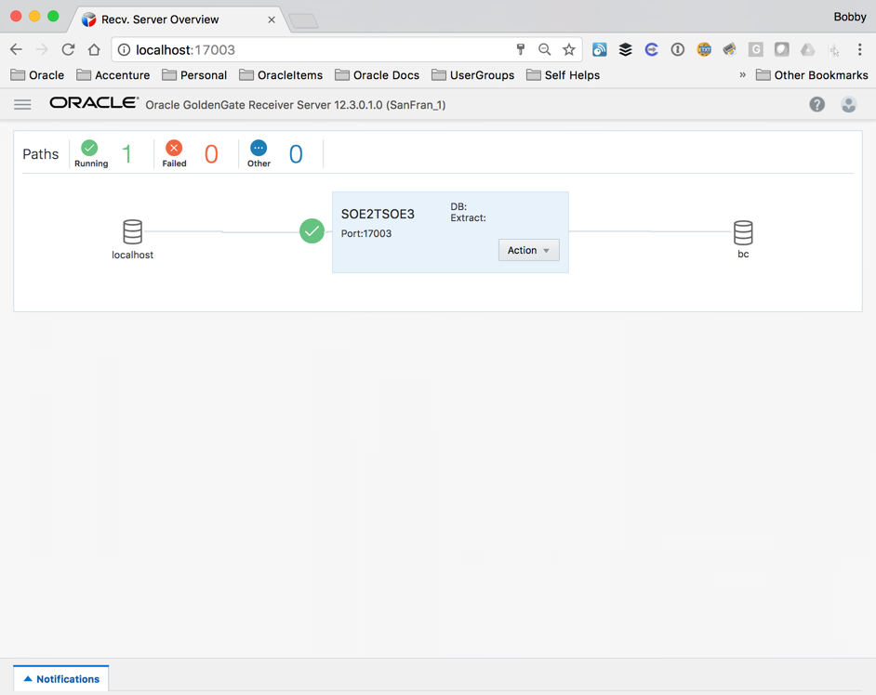
Oracle GoldenGate Receiver Server
Access via URL (http(s)://<hostname>:<port>)
i.e. http://localhost:17003
Replacement for Collector
Single source that handles multiple incoming trail files
View statistics of path
Tune network parameters

Slide 33
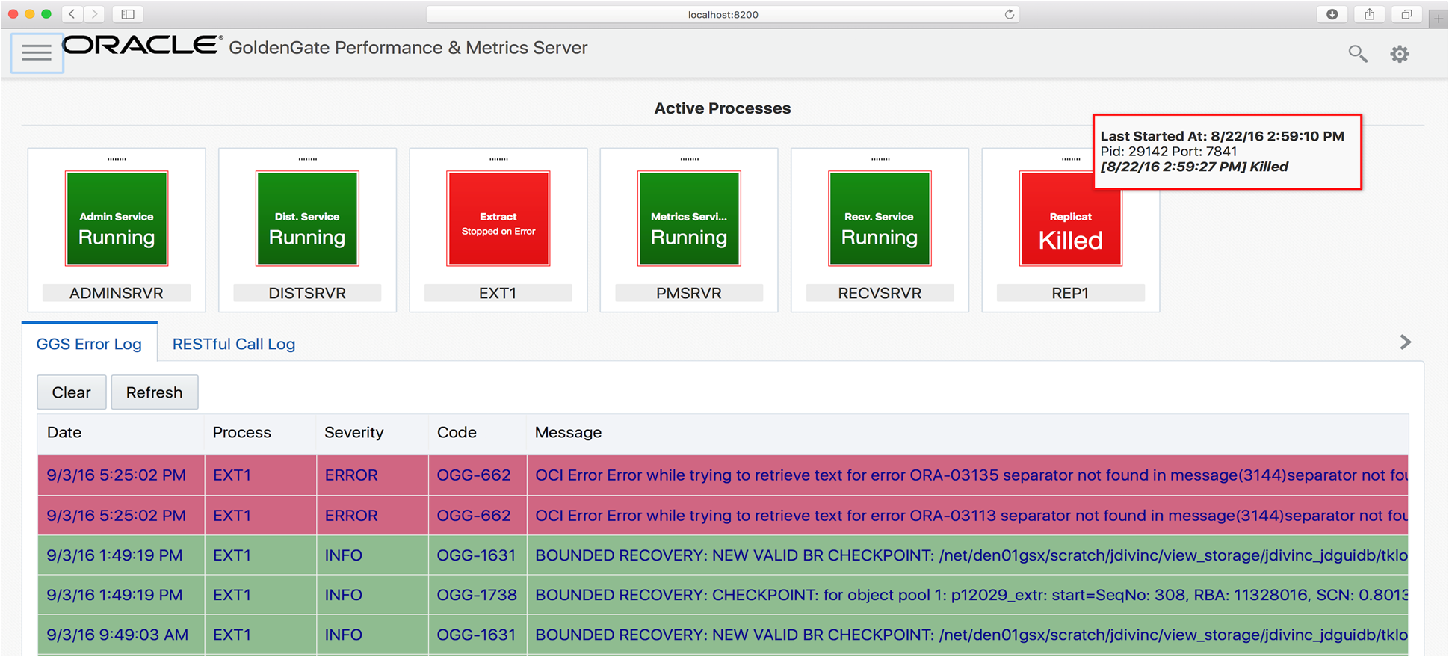
Performance Metrics Server
Metrics Service
Separate the metrics collection and repository from the administrative layer
All GoldenGate processes send metrics via UDP to the metrics server
Metrics server provide RESTful API to query metrics. Responses in either
12.2 XML format
New JSON format
Supports integration with third party tools
MUST have Oracle Management Pack for Oracle GoldenGate

Slide 34
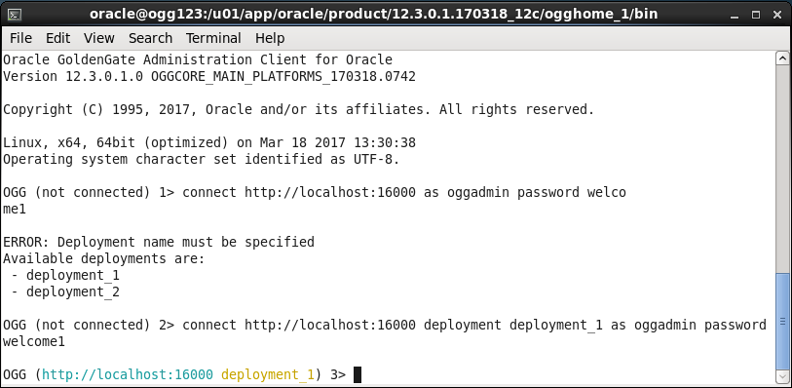
Oracle GoldenGate Administration Client (adminclient)
New thin client command line tool
Offers similar functionality as GGSCI, now includes rlwrap
Runs from $OGG_HOME/bin
$OGG_HOME can be on any machine, does not have to be directly on server
Supported on Windows and Linux

Slide 35
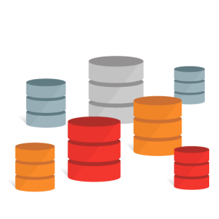
Administration Client (adminclient)
Interact with multiple deployments from a single command line tool
Runs from any machine using RESTful calls

Slide 36
Oracle GoldenGate RESTful APIs
Representational State Transfer (RESTful) Application Program Interface (API)
Uses HTTP requests
GET, PUT, POST, and DELETE
Can be used with many different programming languages
PL/SQL
Perl
Shell
JSON
Etc…
Simple interaction from command line using CURL (examples in the lab)

Slide 37
GoldenGate Microservices
To
GoldenGate Classic

Slide 38




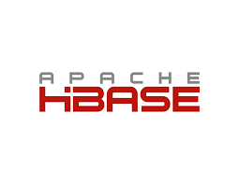
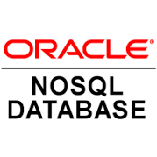





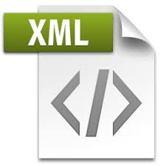


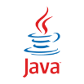




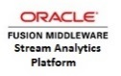





Oracle GoldenGate for Big Data
HDFS
Hive
High Level Architecture
Kafka
Flume
GoldenGate for Big Data
HBASE
Mongo
Cassandra
Capture
Trail Files
Network
Firewall
Cloud
Trail Files
Native Java Replicat
Elastic
JMS
OSA
Kinesis
Heterogeneous Data sources
JDBC
Parameter
File
Adapter
Properties
JAR
JMS

Slide 39
Oracle to Kafka – GoldenGate Microservices
Architecture – High Level – Microservices + OGG4BD
On-Premises Applications
On-Premises
Customizable Interactive Experience
>>SQL
>HTML
>>CLI
>>API
ServiceManager
Oracle RDBMS
11.2.x/12.x/18.x
Deployment 1 (AS)
OGG4BD
Capture
Trail Files
Reverse Proxy
Distro Service
MGR
Trail Files
Delivery

Slide 40
GoldenGate Capture Techniques

Slide 41


GG Real Time – Real Time Mode “On Box”
Source database and Integrated Extract process are in the same machine
User/Application changes
Record changes
Capture changes
LCR1
LCR2
Trail
File
…..
LCR3
Capture
….
….
….
Redo Logs
Logical Change
Records
Integrated Extract
Oracle Database
Source Machine

Slide 42

GG Real Time Architecture Cloud / Hub
On Source Server – Integrated Extract
Record changes
Capture changes
LCR1
LCR2
DB Log
Capture
…..
LCR3
….
SQL*Net
….
….
Redo Logs
Logical Change
Records
Integrated Extract
Oracle Database
Source Machine
GoldenGate Machine
Single Integrated Extract writing to a local trail

Slide 43
GG Real Time Architecture – Downstream
Source database and Integrated Extract processes are in different machine
User/Application changes
Record changes
Capture changes
LCR1
Continuous REDO
Shipping
LCR2
DB Log
Capture
…..
Capture
LCR3
Capture
….
….
….
Redo Logs
Standby
Redo Logs
Logical Change
Records
Oracle Database
Oracle Database
Source Machine
Downstream Machine

Slide 44
GG NON Real Time Architecture – Archive Log Mode
Source database and Integrated Extract process are in different machine
User/Application changes
Record changes
Capture changes
LCR1
LCR2
DB Log
Capture
Capture
LCR3
Capture
…..
Archive Logs
….
….
….
Redo Logs
Logical Change
Records
Oracle Database
Oracle Database
Source Machine
Downstream Machine

Slide 45
GG Real Time – Real Time Mode “On Box”
Source database and Integrated Extract process are in the same machine
User/Application changes
Record changes
Capture changes
LCR1
LCR2
Trail
File
…..
LCR3
Capture
….
….
….
Redo Logs
Logical Change
Records
Integrated Extract
Oracle Database
Source Machine

Slide 46
GG Real Time – Real Time Mode “On Box”
Source database and Integrated Extract process are in the same machine
User/Application changes
Record changes
Capture changes
LCR1
LCR2
Trail
File
…..
LCR3
Capture
….
….
….
Redo Logs
Logical Change
Records
Integrated Extract
Oracle Database
Source Machine

Slide 47
GoldenGate Veridata

Slide 48
Oracle GoldenGate Veridata
Top Reasons We See Why Data Goes Out of Sync
Human Error. We work in very complex, error prone environments
Source data is unknowingly corrupted
You inherited bad data
Out of bounds Globalization characters & bad dates become NULLs during DB copy
Data Migration causes data mismatch
Target data is accidentally deleted or updated outside of replication
"Nologging” set for source transactions
Gaps during data instantiation
Application upgrades not coordinated between source and target
Notes:
Veridata
Overview:
High speed heterogeneous comparisons
Low impact: no locking; hash, sort and compare outside of database
Subset rows/columns; keep audit history; visualize health

Slide 49
Oracle GoldenGate Veridata
Overview
High-speed heterogeneous data comparison and repair
Works with or without real-time data replication
Low impact
No table locking
Data hashing, sorting, and comparison happen outside the database
Supports data subsetting
Maintains comparison audit history and detailed statistics
Data repair for heterogeneous database environments
Export Utility
Delta Processing
Use GoldenGate configuration to automate Veridata configuration
Notes:
Veridata
Overview:
High speed heterogeneous comparisons
Low impact: no locking; hash, sort and compare outside of database
Subset rows/columns; keep audit history; visualize health

Slide 50


Oracle GoldenGate Veridata
Architecture
Web Client
Server Sorts Rows, Compares Hash, Generates COOS
HTTP
Veridata Agent
Veridata
Web Server
JDBC
TCP/IP / SSL
Source Database
JDBC
Agent Hashes Row & Sends PK + Hash
GoldenGate
Veridata Repository
OGVPP Utility
TCP/IP / SSL
Veridata Agent
Run Compare CLI
(Vericom)
Import and Export Utilities
(Scripting)
JDBC
Target Database

Slide 51
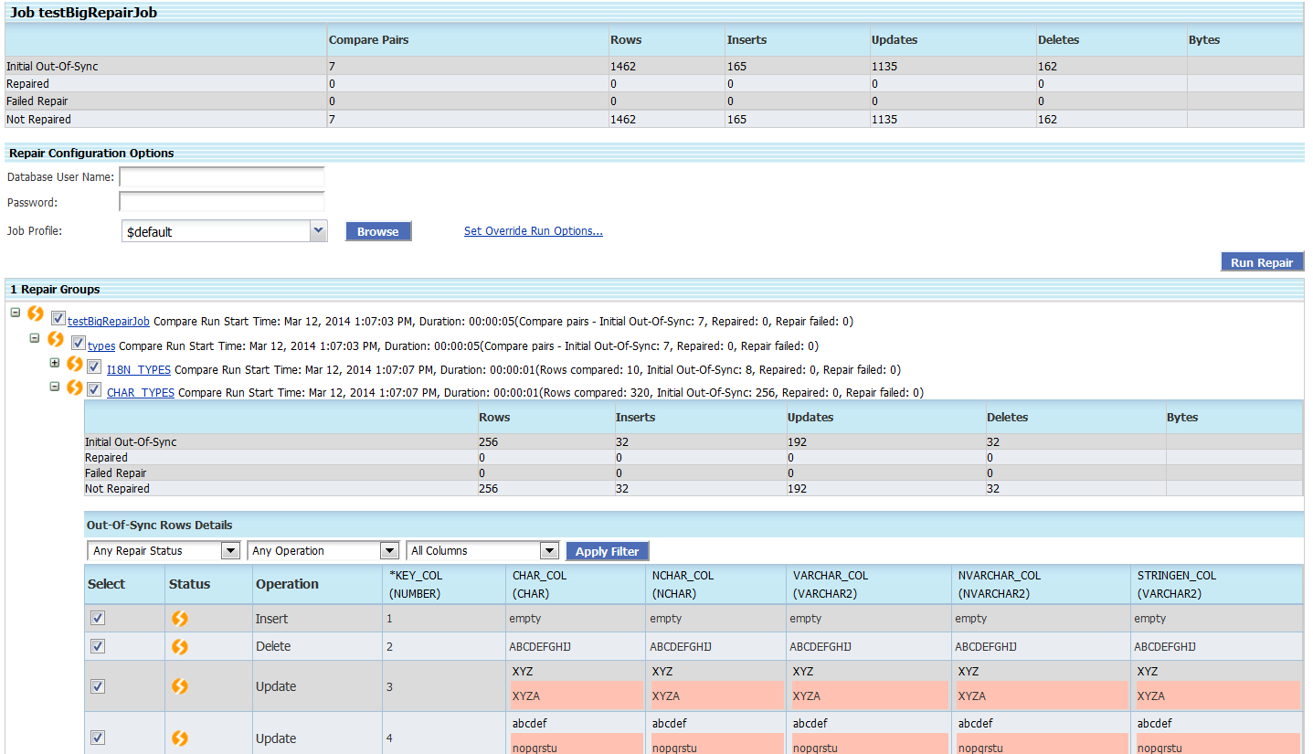
Oracle GoldenGate Veridata
Summarize and Repair Out of Sync Data
Notes:
Veridata
Overview:
High speed heterogeneous comparisons
Low impact: no locking; hash, sort and compare outside of database
Subset rows/columns; keep audit history; visualize health
New Features:
Heterogeneous data Repair!
SSL and IPv6 for Agents
Oracle Web Logic Server 12.1.3 integration
Single Sign on
Encrypt comparison reports (.rpt, .oos, .oosxml)
Enhanced security, navigation, and more…
Purge old reports - from repository and on file system
Scripting tool (Load config API)

Slide 52
Oracle GoldenGate 18c Mircoservices Workshop

Slide 53
What to Expect - Lab Structure
Hands on work in a VM running Oracle Enterprise Linux 7
Screen shots use Tight TightVNC viewer in the guides
Download TightVNC Viewer
Multiple Environments
Oracle Database 18c and MySQL 8.0.13
Oracle Source URN: SOE/soe@OGGOOW181
Oracle Target URN: SOE/soe@OGGOOW182
You will install OGG-MSA for 18c (This is prerequisite for all the Labs )
Labs
All labs are available at the following link :
https://github.com/OracleCPS/GGMicroservices/tree/master/workshops/gg
OR
https://tinyurl.com/y36g2fv8
Read the Labs from 1-9, view the files, explore the file system to get the most out of Labs

Slide 54
What to Expect - Lab Structure
Lab guides uses Multiple Browser sessions & Terminal sessions for labs when logged in using VNC viewer
Open up a browser window in your client VM environment in Ravello VNC viewer, enter the following URL and port: http://localhost:16000
If you're using the browser on your laptop, change localhost to the Ravello URL or IP Address your instructor gave out at the beginning of the workshop same one you used for the VNC Session.
Lab 1 and Lab 2 are Mandatory

Slide 55
What to Expect - Lab Structure
Description | URL From browser | Value
Deployment Name |  | Atlanta
Service Manager Port | http://<localhost> or <Hostname/IP>:16000 | 16000
Administration Server Port | http://<localhost> or <Hostname/IP>:16001 | 16001
Distribution Server Port | http://<localhost> or <Hostname/IP>:16002 | 16002
Receiver Server Port | http://<localhost> or <Hostname/IP>:16003 | 16003
Metrics Server Port | http://<localhost> or <Hostname/IP>:16004 | 16004
Description | URL From browser | Value
Deployment Name |  | SanFran
Service Manager Port | http://<localhost> or <Hostname/IP>:16000 | 16000
Administration Server Port | http://<localhost> or <Hostname/IP>:17001 | 17001
Distribution Server Port | http://<localhost> or <Hostname/IP>:17002 | 17002
Receiver Server Port | http://<localhost> or <Hostname/IP>:17003 | 17003
Metrics Server Port | http://<localhost> or <Hostname/IP>:17004 | 17004

Slide 56
Available Labs
Lab 1 Install GG Microservices Architecture 18c
Lab 2 Creating Deployments
Lab 3 Creating Credentials
Lab 4 Uni Directional and DDL Replication
Lab 5 Zero Downtime Configuration
Lab 6 Bi-Directional and Auto Conflict Detection and Resolution(CDR)
Lab 7 Heterogeneous Replication
Lab 8 Data Transformations
Lab 9 Performance Metrics

Slide 57
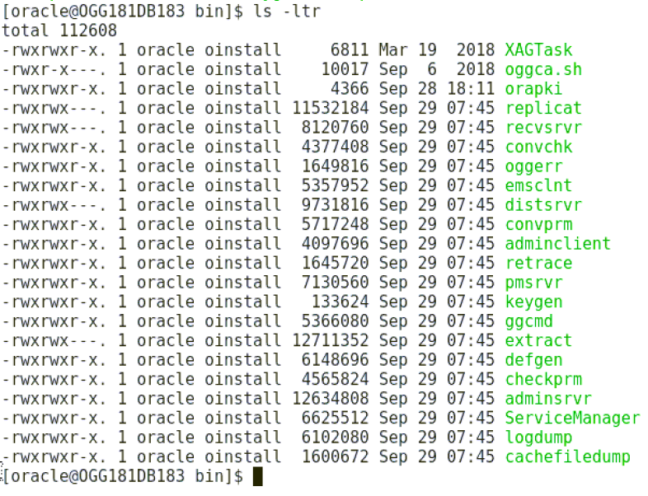
Lab 1 – Install GG Microservices Architecture…. cntd
Install GoldenGate Microservices Archiecture 18.1.0.0.0 for Oracle Database 18.3.0.0.0
Oracle Universal Installer is used for install process.
Setup Install Location
Make sure you have already started up the databases
[oracle@OGG181DB183 Lab1]$ ./startup.sh
Review directory structure
OGG_HOME
bin
oggca.sh
adminclient
ServiceManager
deinstall

Slide 58
Lab 2 - Creating Deployments
Configure ServiceManager and Register Service Manager as a system daemon
Configure deployment “Atlanta” using Goldengate MicroServices 18.1 web interface
Oracle GoldenGate Configuration Assistant (OGGCA) – oggca.sh
Configure SanFran deployments using silent script
./create_deployment.sh
ServiceManager
Oracle RDBMS
11.2.x/12.x/18.x
Deployment “Atlanta”
Performance Metrics
Deployment “Sanfran”
Performance Metrics
Distro Service
Recevier Service
Capture
Trail Files
Trail Files
Delivery
Network
WSS, WS, ogg, udp

Slide 59
Lab 2 - Creating Deployments….cntd
Review directory structure
DeploymentHome/etc-> Configuration Files
DeploymentHome/etc/conf-> Configuration bootstrap files, process parameter files
DeploymentHome/etc/ssl-> Security configuration files
DeploymentHome/var->Runtime and support files
DeploymentHome/var/lib/data->Trail files

Slide 60
Lab 2 - Creating Deployments
Description | URL From browser | Value
Deployment Name |  | Atlanta
Service Manager Port | http://<localhost> or <Hostname/IP>:16000 | 16000
Administration Server Port | http://<localhost> or <Hostname/IP>:16001 | 16001
Distribution Server Port | http://<localhost> or <Hostname/IP>:16002 | 16002
Receiver Server Port | http://<localhost> or <Hostname/IP>:16003 | 16003
Metrics Server Port | http://<localhost> or <Hostname/IP>:16004 | 16004
Description | URL From browser | Value
Deployment Name |  | SanFran
Service Manager Port | http://<localhost> or <Hostname/IP>:16000 | 16000
Administration Server Port | http://<localhost> or <Hostname/IP>:17001 | 17001
Distribution Server Port | http://<localhost> or <Hostname/IP>:17002 | 17002
Receiver Server Port | http://<localhost> or <Hostname/IP>:17003 | 17003
Metrics Server Port | http://<localhost> or <Hostname/IP>:17004 | 17004

Slide 61
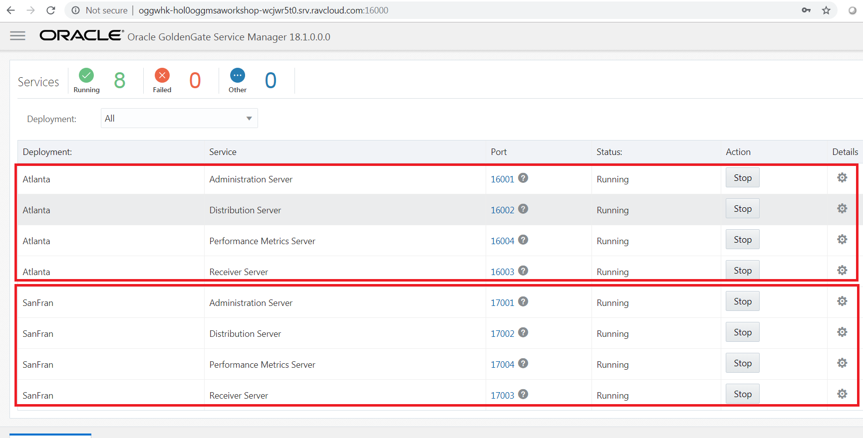

Slide 62
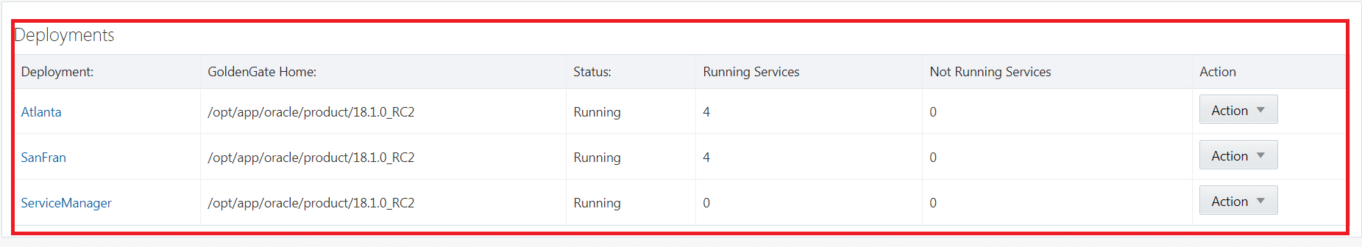

Slide 63
Lab 3 - Creating Credentials
Create Source Database and Protocol User Credentials for setting up the Goldengate Processes using web console
Field/Checkbox | Setting
Credential Domain | OGG
Credential Alias | SGGATE
User ID | C##GGATE@orcl
Password | ggate
Verify Password | ggate
Field/Checkbox | Setting
Credential Domain | OGG
Credential Alias | WSTARGET
User ID | oggadmin
Password | Welcome1
Verify Password | Welcome1
Create Target Database User Credentials using Rest API (Curl)
Field/Checkbox | Setting
Credential Domain | OGG
Credential Alias | TGGATE
User ID | GGATE@OGGOOW182
Password | ggate
Verify Password | ggate

Slide 64
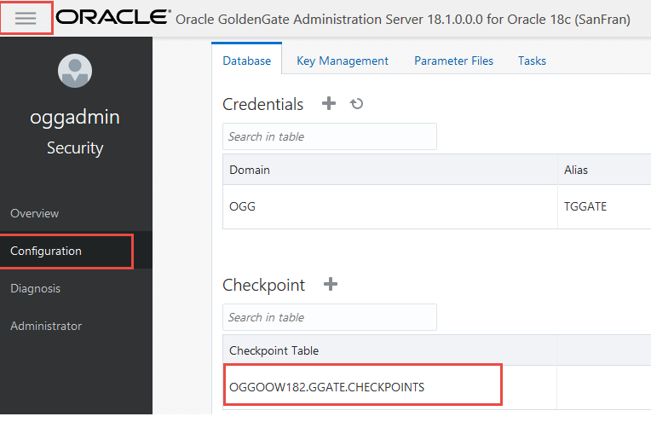
Lab 3 - Creating Credentials….cntd
Create the target GoldenGate checkpoint table using the REST API
Verify once created via webconsole

Slide 65
Lab 4 - Uni-Directional and DDL Replication
Configure one way replication to target database where both databases are already in sync
Using Web interface of Oracle GoldenGate Microservices (HTML5 Pages)
Validate credentials
Add SCHEMATRANDATA to the SOE schema
Create Integrated Extract
Create Distribution Stream
Create Integrated Replicat
Run Swingbench script to apply data to the source database

Slide 66
Lab 4 - Uni-Directional and DDL Replication….cntd
Perform DDL changes and verify
Create, Delete, Tuncate and alter tables
Insert, update and delete records
ServiceManager
Oracle RDBMS
11.2.x/12.x/18.x
Deployment “Atlanta”
Deployment “Sanfran”
Oracle RDBMS
11.2.x/12.x/18.x
SOE2SOE
Distro Service
Recevier Service
Capture : EXT1
Trail Files :aa
Network
WS
Trail Files :bb
Delivery : REP1

Slide 67
Lab 5 - Zero Downtime Configuration
**Remove the previous lab replication processes with via the REST API using Curl commands
Oracle to Oracle zero down time configuration using
Oracle GoldenGate Initial Load and Change Sync configuration
File based data migration(GoldenGate initial load) using the Microservices architecture and the REST API for automation.
Steps
Create and start Extract : EXT2
Create and start Distribution Path: TSTPATH
Create Replicat : REP2
Creates and start the Initial Load Extract Task
Creates and start the Initial Load Distribution Path
Create and start the Initial Load Replicat (need to monitor and stop once done)
Start Replicat: REP2 -----------> using END RUNTIME and HANDLECOLLISIONS

Slide 68
Lab 5 - Zero Downtime Configuration
ServiceManager
Deployment “Atlanta”
Deployment “Sanfran”
INITLOAD
Distro Service
Recevier Service
Trail Files :
CB
Initial Delivery : RLOAD
Initial Capture :
LOAD
Trail Files : CA
Network
WS
Oracle RDBMS
11.2.x/12.x/18.x
Oracle RDBMS
11.2.x/12.x/18.x
TSTPATH
Distro Service
Recevier Service
Capture : EXT2
Trail Files : X1
Network
WS
Trail Files :X2
Delivery : REP2

Slide 69








GoldenGate Usage – Zero Downtime Migration
Now testers can confirm that the application will work correctly with live data and not affect production.
OLTP Users
Testers
Once instantiation is complete, deliver the real-time transactions to new database handling collisions.
Once testing is complete, start replication back to primary from new database. Enables a fallback option.
Switch OLTP users to new database. If problems occur, can immediate fallback to “old” database.
Instantiate new database with primary data while OLTP users are active. Can use any method preferred.
OLTP users are connected to primary server. The new database is empty.
Start GoldenGate capture process & store transactions in trail. Eliminates need for point-of-consistency.
Initial Instantiation
Oracle 11g
Linux
Oracle 12c
Linux
Capture / Extract
Delivery / Replicat
Trail

Slide 70
Lab 6 - Bi-Directional and Auto Conflict Detection and Resolution(CDR)
Remove and recreate deployments via script
Drops the existing container databases.
Clones two container databases from a base container.
Deletes the two deployments (Atlanta and SanFran). This will remove any current lab setups.
Creates the two deployments again i.e. Atlanta and Sanfran
Creates new credentials for both deployments.
Adds Schema supplemental logging to both container databases for the SOE schema.
Adds checkpoint tables on both container databases.
Adds the Extract, Distribution Path and Replicat for both deployments. This includes the parameters for the Extract and Replicats.

Slide 71
Lab 6 - Bi-Directional and Auto Conflict Detection and Resolution(CDR)….cntd
Check the deployment using the AdminClient
OGG (http://localhost:16000 Atlanta) 3> connect http://localhost:16000 deployment Atlanta as oggadmin password Welcome1
OGG (http://localhost:16000 Atlanta) 3> help
OGG (http://localhost:16000 Atlanta) 4> info all
OGG (http://localhost:16000 Atlanta) 27> health deployment Atlanta
Automatic conflict detection and resolution does not require application changes for the following reasons:
Oracle Database automatically creates and maintains invisible timestamp columns.
Inserts, updates, and deletes use the delete tombstone log table to determine if a row was deleted.
LOB column conflicts can be detected.
Oracle Database automatically configures supplemental logging on required columns.
Setup Auto CDR on tables -------> ./setup_autocdr.sh
e.g. exec DBMS_GOLDENGATE_ADM.ADD_AUTO_CDR('soe','addresses');

Slide 72
Lab 6 - Bi-Directional and Auto Conflict Detection and Resolution(CDR)….cntd
Auto CDR handles Various DML Conflicts
Type of Conflicts | Existing CDR | Auto CDR
Insert Conflict | ✔ | ✔
Delete Conflict | ✔ | ✔
Update Conflict | ✔ | ✔
Delta Resolution | ✔ | ✔
Insert-Update/Delete Conflict | ✖ | ✔
Column Group Conflicts | ✖ | ✔
Piecewise LOB Update | ✖ | ✔

Slide 73
Lab 6 - Bi-Directional and Auto Conflict Detection and Resolution(CDR)….cntd
ServiceManager
Deployment “Atlanta”
Performance Metrics
Deployment “Sanfran”
Performance Metrics
SOE2SOE2
Distro Service
Recevier Service
Trail Files :
bb
Delivery : IREP1
Trail Files : bA
Network
WS
Capture: EXTSOE2
Oracle RDBMS
11.2.x/12.x/18.x
Oracle RDBMS
11.2.x/12.x/18.x
SOE2SOE1
Distro Service
Recevier Service
Capture : EXTSOE1
Trail Files : aa
Network
WS
Trail Files : ab
Delivery : REP2

Slide 74
Lab 7 : Heterogeneous Replication
Configure Oracle GoldenGate for "MySQL" using classic Architecture for Capture
Configure Oracle GoldenGate for "Oracle" using Microservices Architecture for Delivery
ServiceManager
MySql 8.0.13
Manager
OGG for MySQL
Deployment “Sanfran”
Oracle RDBMS
11.2.x/12.x/18.x
Pump
Recevier Service
Capture : E_MYSQL
Trail Files :eo
Trail Files :rt
Delivery : R_MY_SQL
Network
ogg

Slide 75
Lab 7 : Heterogeneous Replication….cntd
At Source
SOURCEDB amea@localhost:3306, USERID root, PASSWORD Welcome1
TRANLOGOPTIONS ALTLOGDEST /u01/mysql/log_bin/mysql-bin.index
Trail includes metadata across heterogeneous replication

Slide 76
Lab 8 : Data Transformations
Demonstrate use of Oracle GoldenGate Microservices for transformation capabilities like column concatenating, data masking and use of Environment variables/tokens
Concatenating the two source columns into target single columns
MAP OGGOOW181.SOE.CUSTOMERS, TARGET OGGOOW182.SOE.CUSTOMERS, KEYCOLS(customer_id), & COLMAP (USEDEFAULTS,CUSTOMER_NAME =@STRCAT(CUST_FIRST_NAME,' ',CUST_LAST_NAME));
Masking the Source Crucial email-id's into a dummy email-id in the target.
CREATE OR REPLACE FUNCTION F_MAIL(CODE_PARAM IN VARCHAR2)
RETURN VARCHAR2
IS DESC_PARAM VARCHAR2(100);
BEGIN
RETURN 'XXXXXXXXX@dummy.com';
END;

Slide 77
Lab 8 : Data Transformations….cntd
CREATE OR REPLACE PROCEDURE P_MAIL (CODE_PARAM IN VARCHAR2,DESC_PARAM OUT VARCHAR2)
IS
begin
select F_MAIL('CODE_PARAM')
into DESC_PARAM
from dual;
end;
MAP OGGOOW181.SOE.CUSTOMERS, TARGET OGGOOW182.SOE.CUSTOMERS, keycols(customer_id), &
SQLEXEC (SPNAME P_MAIL, PARAMS (code_param = CUST_EMAIL)), &
COLMAP (USEDEFAULTS, CUST_EMAIL = P_MAIL.desc_param,CUSTOMER_NAME =@STRCAT(CUST_FIRST_NAME,CUST_LAST_NAME));
Use of Tokens.

Slide 78
Lab 8 : Data Transformations….cntd
Use of Environment Variables/Tokens
MAP OGGOOW181.SOE.LOGON, TARGET OGGOOW182.SOE.LOGON_AUDIT, KEYCOLS(LOGON_ID), &
COLMAP (USEDEFAULTS,&
host=@GETENV('GGENVIRONMENT','HOSTNAME'),&
gg_group=@GETENV ('GGENVIRONMENT','GROUPNAME'),&
osuser=@GETENV ('GGENVIRONMENT','OSUSERNAME'),&
domain=@GETENV ('GGENVIRONMENT','DOMAINNAME'),&
ba_ind=@GETENV ('GGHEADER','BEFOREAFTERINDICATOR'),&
commit=@GETENV ('GGHEADER','COMMITTIMESTAMP'),&
pos=@GETENV ('GGHEADER','LOGPOSITION'),&
rba=@GETENV ('GGHEADER','LOGRBA'),&
tablename=@GETENV ('GGHEADER','TABLENAME'),&
optype=@GETENV ('GGHEADER','OPTYPE'));

Slide 79
Lab 8 : Data Transformations….cntd
ServiceManager
Oracle RDBMS
11.2.x/12.x/18.x
Deployment “Atlanta”
Deployment “Sanfran”
Oracle RDBMS
11.2.x/12.x/18.x
SOE2SOE1
Distro Service
Recevier Service
Capture : EXT1
Trail Files :aa
Network
WS
Trail Files :ab
Delivery : REP1

Slide 80
Lab 9 : Performance Metrics
View the detailed replication statistics in real-time with the Oracle GoldenGate Metric Service in Microservices Architecture
Performance Metrics Server
http://<localhost or Hostname/ip>:17004/
ServiceManager
Oracle RDBMS
11.2.x/12.x/18.x
Deployment “Atlanta”
Performance Metrics
Deployment “Sanfran”
Performance Metrics
Oracle RDBMS
11.2.x/12.x/18.x
SOE2SOE1
Distro Service
Recevier Service
Capture : EXT1
Trail Files :aa
Network
WS
Trail Files :ab
Delivery : REP1

Slide 81
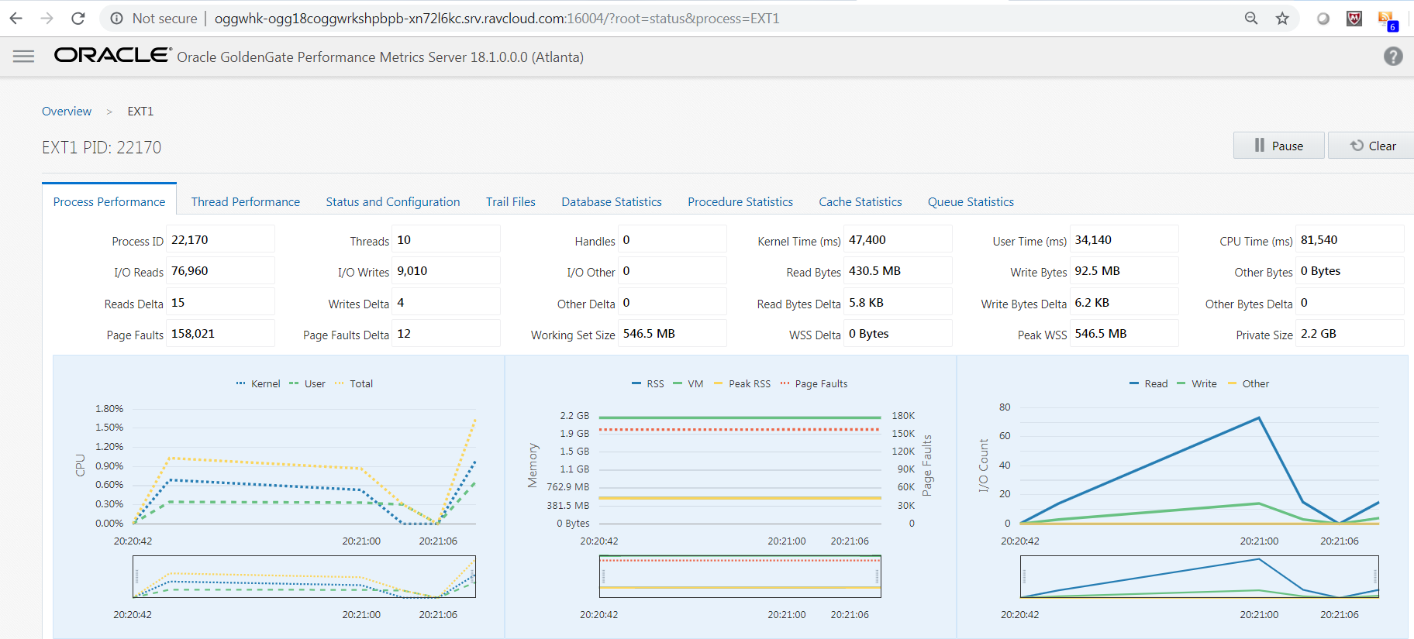

Slide 82

Questions and Answers

Slide 83





Connect with Oracle Data Integration
Oracle Data Integration
@OracleDI
Blogs.oracle.com/DataIntegration/
Oracle Data Integration

